Slide 1

How To Use this Pitchdeck
  Read the instructions for Steps 1–6 carefully
  Add all necessary explanations to each slide
  Add an image or mockup of your design in Step 4
  You're free to adapt the slides to your idea's visual identity, e.g. using the icons on this page or other free resources
  This is a pitch deck, so make sure your arguments are convincing and easy to understand — every detail matters!
  Delete this page before submitting your final presentation.

Slide 2


Your Logo
Zero Debris Design
Pick an Attractive Slogan
Add your names and team name

Slide 3
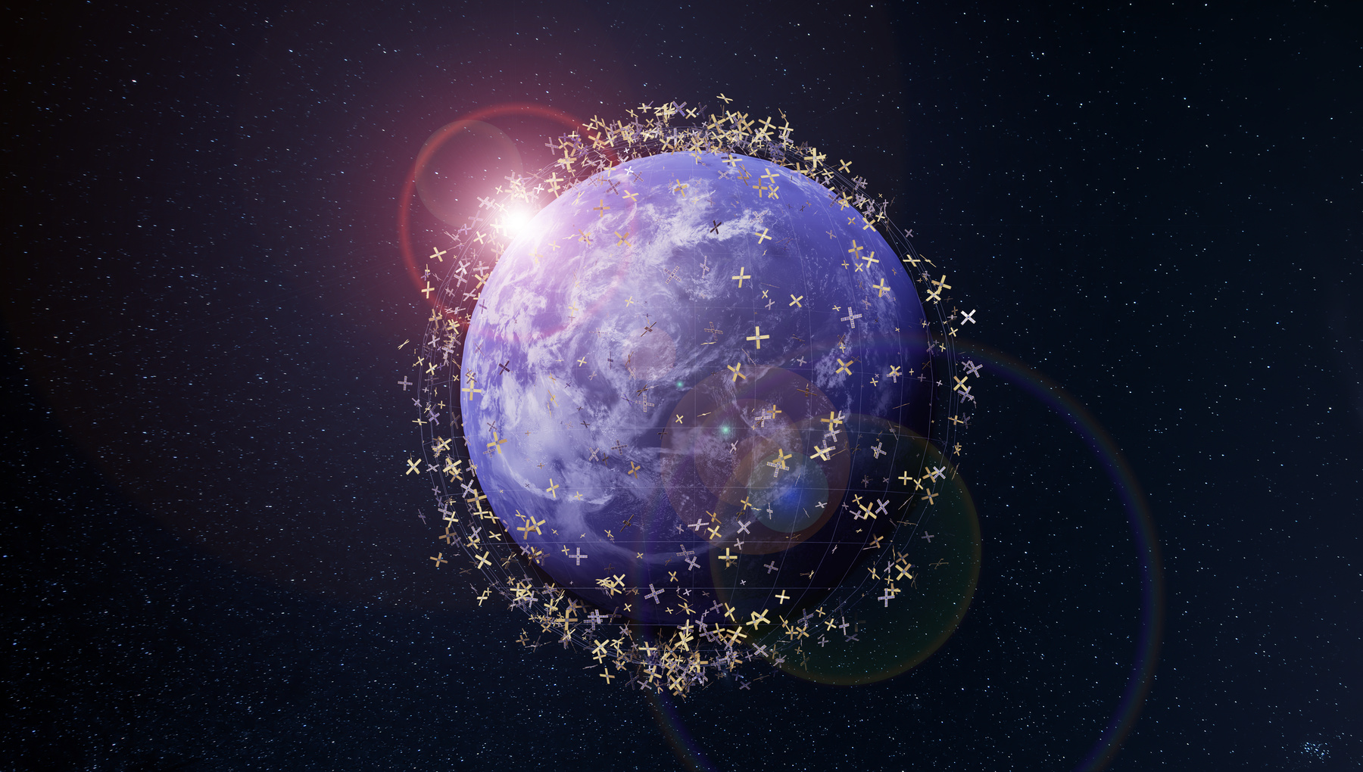
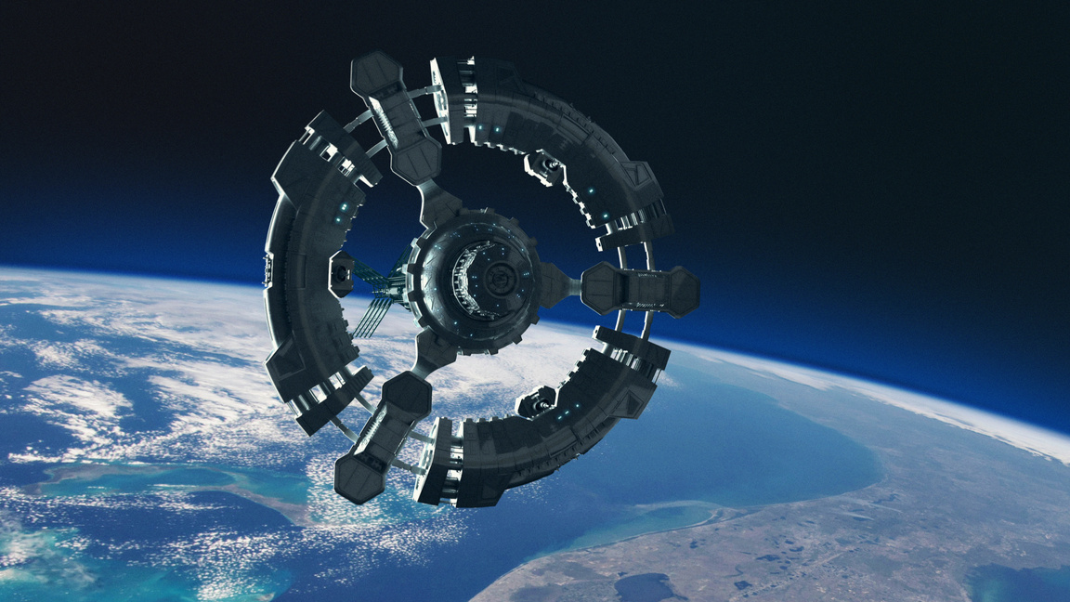
Step 1: Understand the Problem and Context
Show your understanding of the problem you are trying to address: space debris created by failed or broken objects in orbit.
Be clear about what part of the problem you want to focus on and what success would look like for your solution.
Consider:
  Scope: What specific problem are you focusing on?
  Design goal: What would “safe failure” look like for your chosen component?
  Impact: Why is reducing this type of space debris important for future satellites and space missions?

Slide 4
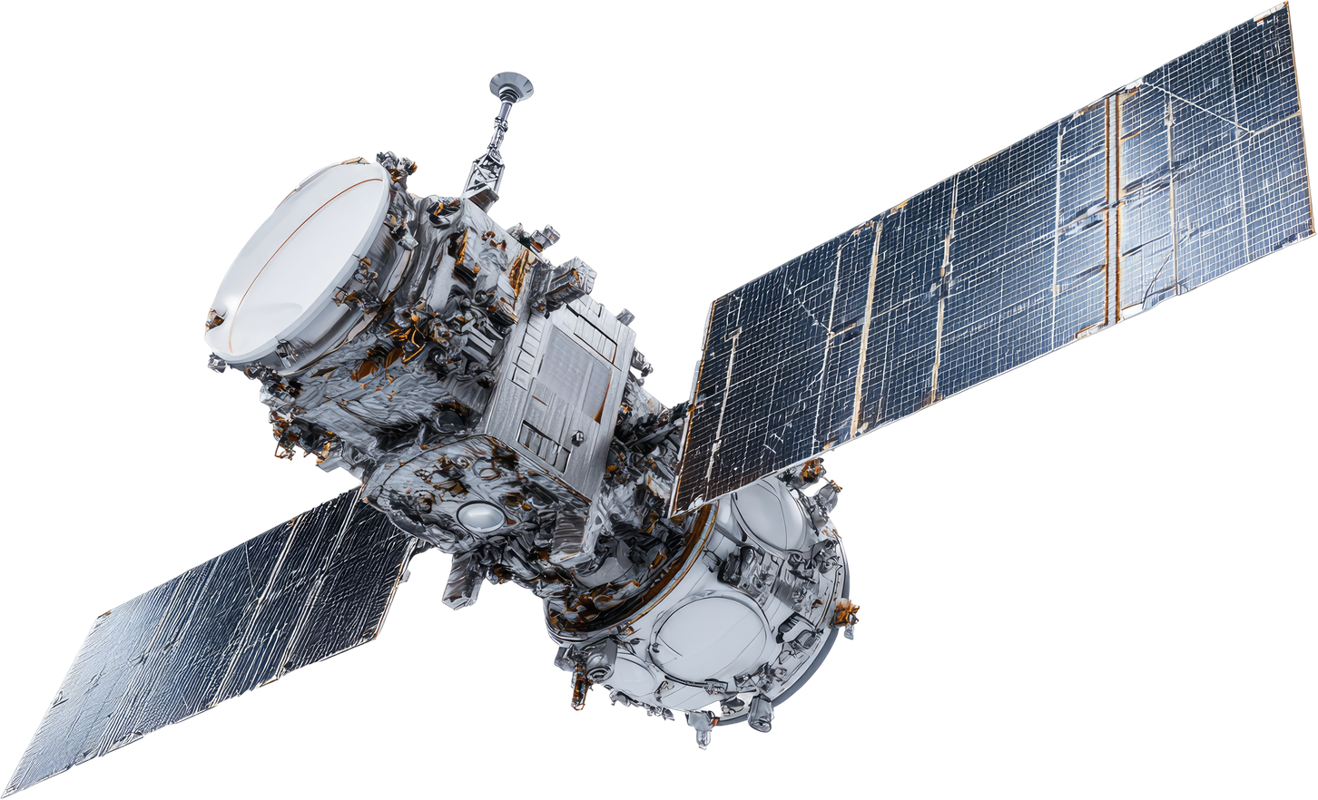
Step 2: Choose Your Component for Redesign
Every spacecraft has many important systems, and each behaves differently in space. Understanding your component’s role helps you design something realistic and meaningful.
Choose one spacecraft part that you will redesign for safer failure behavior.
This is the object you will improve, not the whole spacecraft.
Consider:
  Function: What does your component do during normal operation of the spacecraft?
  Importance: Why is this part critical for the mission?
  Context: Where is it used in the spacecraft (inside, outside, moving part, exposed to space conditions)?

Slide 5
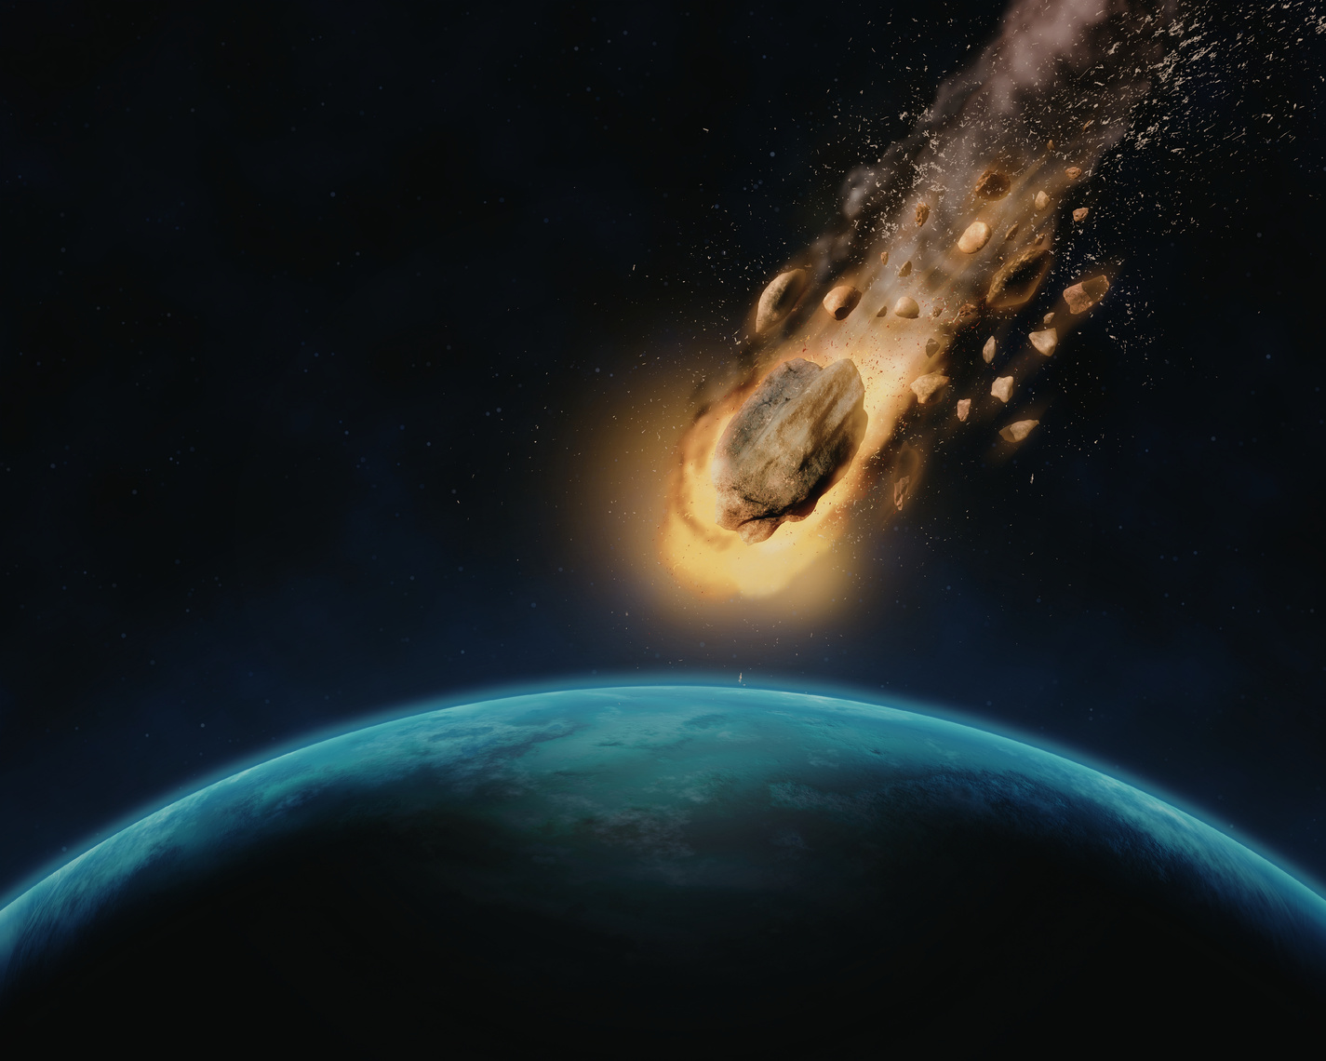
Step 3: Failure Scenarios and Risk Analysis
How and why could your chosen component fail in space? How would its debris behave?
Space is a harsh environment with radiation, extreme temperatures, vacuum conditions, and mechanical stress during launch and operation.
Consider:
  Failure modes: Could it explode, crack, overheat, detach, break apart, ...?
  Trigger causes: What could lead to failure (pressure, collision, temperature, aging)?
  Debris risk: What happens to the pieces, what kind of debris can be created? What would happen during the re-entry?

Slide 6
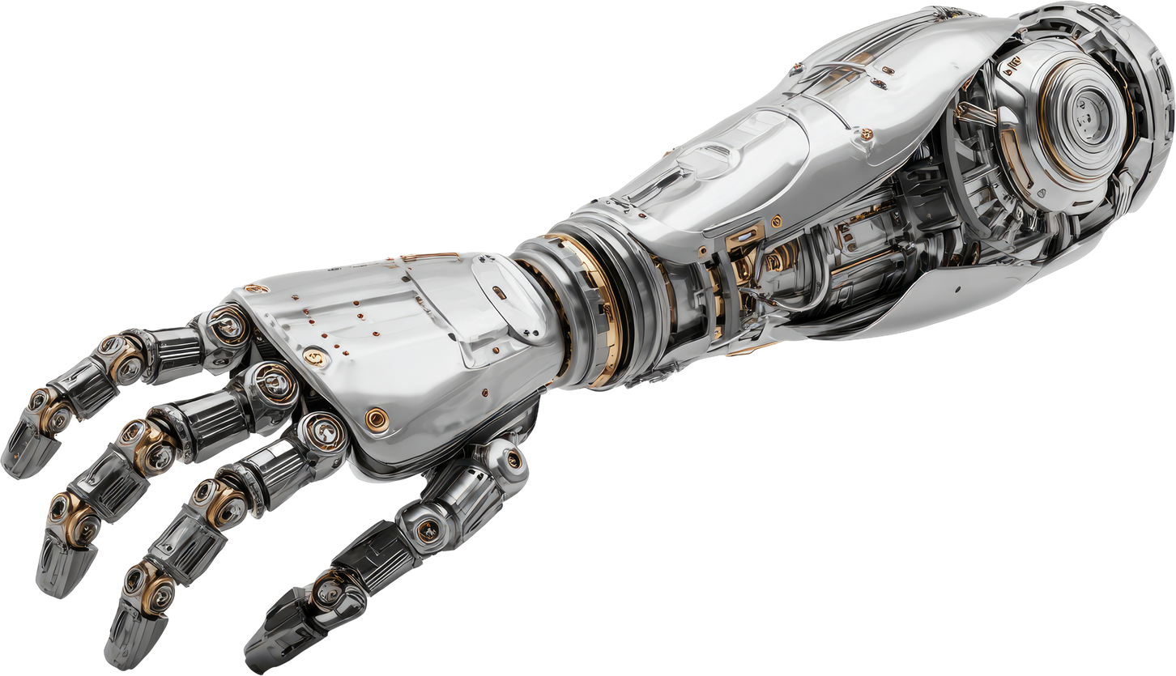
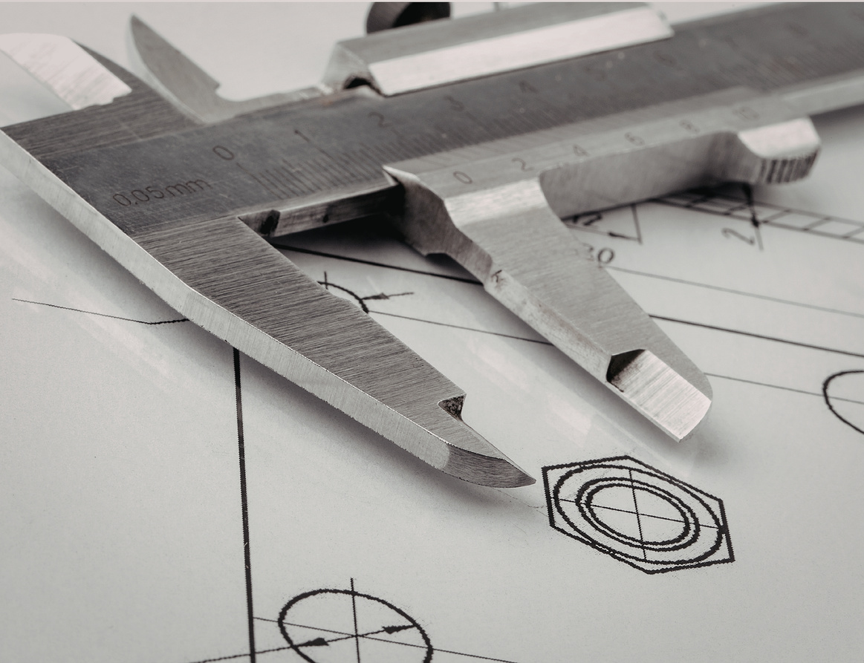
Step 4: Design Concept and Debris Mitigation
Redesign the component so that if it fails, it produces minimal harmful debris.
You may consider strategies such as:
  using materials that burn up more easily in the atmosphere
  designing parts to break into fewer or less dangerous pieces
  adding systems that release pressure safely before explosion
  creating structures that contain fragments instead of scattering them
Consider:
  Debris reduction strategy: How does your redesign reduce the amount or danger of fragments? Show your design!
  Failure behaviour: What physically happens when the component breaks?
  Safety mechanism: What built-in feature makes failure safer?
Your Logo

Slide 7

Step 5: Solution Analysis
Explain why your design works and what compromises it involves.
Consider:
  Assumptions: What conditions are you assuming in space (pressure, temperature, impact)?
  Trade-offs: Does your solution increase weight, cost, or complexity?

Slide 8
Step 6: Ethical, Legal, and Environmental Aspects
Space is a shared and highly regulated environment, and design decisions can have long-term consequences beyond a single mission.
Consider:
  Space sustainability: Does your design help reduce long-term space debris and support a cleaner orbital environment? Could it unintentionally create new risks or long-lasting debris?
  Legal and regulatory awareness: Space activities are governed by international guidelines and best practices for debris mitigation. Does your design align with the idea of minimizing space pollution and respecting shared orbital space?
  Ethical impact: Is your solution considerate of the wider consequences of space activity, including future access to space and the safety of other missions?
ETHICS
REGULATIONS
SUSTAINABILITY

Slide 9
Resource Page
Videos for Inspiration:
  ESA: ESA 2021: Space debris and removal techniques (5 min, in English)
  How debris spread through orbit: Collision and Fragmentation events (2 min, in English)
  ESA 2017: Dealing with space debris
  ESA 2024: Simulating tumbling reaction wheel reentry

